Slide 1
Chapter 12
Measures of Association

Slide 2
Learning Objectives
Explain the concept of the measures of association
Describe the assumptions and statistical significance of Pearson’s product-moment correlation and partial correlation
Explain how the hypotheses are framed for the measures of association
Explain how the research problem is formulated for the measures of association

Slide 3
Demonstrate the steps used in SPSS to execute Pearson’s product-moment correlation and partial correlation
Explain how Pearson’s product-moment correlation and partial correlation are calculated manually
Explain how to analyse and interpret SPSS outputs for the measures of association
Report the final results of Pearson’s product-moment correlation and partial correlation

Slide 4
Introduction
The association between variables is better explained by strength, direction, shape and other dimensions as per the requirement of the analysis.
The technique used in research to investigate the relationship of one variable to another is called bivariate correlation analysis and the correlation coefficient is known as statistical measures of covariance or association between two variables.
This correlation coefficient is denoted by r, and it measures the association between two variables in terms of strength (strong or weak) and direction (positive or negative).
The correlation coefficient (r) ranges from −1.0 to +1.0. The value closer to 1 indicates strong association, and closer to + or – sign indicates positive and negative association, respectively.

Slide 5
Correlation Coefficient
Table 12.1. Correlation Coefficient
Range of r | Interpretation | Range of r | Interpretation
Positive |  | Negative
0.1 to 0.4 | Weak positive | 0.1 to 0.4 | Weak negative
0.5 to 0.6 | Moderate positive | 0.5 to 0.6 | Moderate negative
0.7 to 1.0 | Strong positive | 0.7 to 1.0 | Strong negative

Slide 6
Pearson’s product-moment correlation is a parametric test procedure and is used when both the variables are measured at least interval scale, approximately normally distributed and have linear relationship.
Spearman’s correlation is a non-parametric test technique and is used when population is deviate from the normal distribution and variables are measured at ordinal scale.

Slide 7
Assumptions of Pearson’s Product-Moment Correlation Coefficients (r)
Data scale: Both variables as incorporated in the analysis are continuous in nature and are measured at interval or ratio scale irrespective of their units.
Linear relationship: There should be a linear relationship that exists between the variables of interest. The linear relationship can be checked visually by making the scatter plot.

Slide 8
Absence of outliers: The presence of significant outliers in a data affects the result of association due to their deviation from the usual pattern in the data.
Bivariate normal distribution: Examining bivariate normality is an important assumption for statistical significance of correlation coefficients (r).

Slide 9
Statistical Significance
The significance of r can be assessed by certain level of significance (generally 5% LoS) in SPSS with two-tailed condition. If Sig. (two-tailed) p-value computed by software is less than the criterion value, the r is assumed to be significant at preset LoS and has evidence that the sample r does not occur by chance only, thus leading to reject the null hypothesis of no correlation exists in the population.

Slide 10
Framing Hypothesis
Null hypothesis H₀: ρ = 0
(Population correlation coefficients (ρ) is equal to zero.)
We can also express null hypothesis indicating no relationship between the variables.
H₀: No significant correlation exists between the two variables.
Alternative hypothesis H_{a}: ρ ≠ 0
(Population correlation coefficients (ρ) is not equal to zero.)

Slide 11
Research Problem and Test Technique
Data file multiplex.sav presents the data of randomly selected 60 households depicting the frequency of visits to multiplex by families on annual basis along with their monthly income in US$. Both these variables were measured at ratio scale.

Slide 12
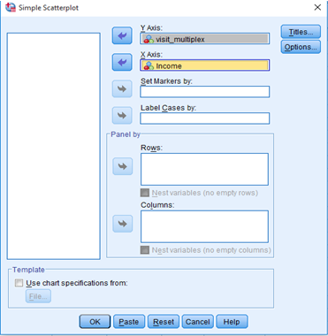
Executing Pearson’s Product-Moment Correlation with SPSS Procedure
Assessing Linear Relationship
Exhibit 12.1. Use multiplex.sav » Graphs » Legacy Dialog » Scatter plot » Select visit_multiplex and transfer in Y Axis » Select Income transfer in X Axis » Click OK

Slide 13
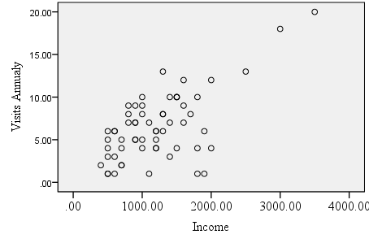
Result of Linear Relationship
The scatter plot indicates a pattern of linear relationship.
It can be observed that as income tends to increase, the frequency of visits also increases, thus showing a positive relationship between the variables.

Slide 14
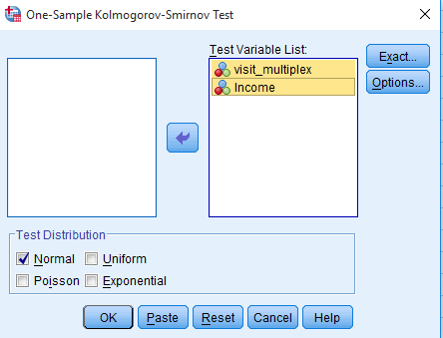
Assessing Normality
Exhibit 12.2. Use multiplex.sav » Menu bar » analyse » Non-parametric test » Legacy Dialogs » One sample KS test » Transfer visit and Income to Test Variable(s) List » Click on Normal Distribution under Test Distribution » Click OK

Slide 15
Results of Normality
Table 12.2. Assessing Normality with One-Sample KS
 | N | Normal Parameters |  | K-S Z | Sig. (2-tailed)
 |  | Mean | Std. Deviation
Visits | 60 | 6.5 | 3.93 | 0.102 | 0.190
Income |  | 1213.33 | 610.21 | 0.105 | 0.163
The p-values for visit (p > 0.05, 0.190) and income (p > 0.05, 0.163) are more than 0.05; hence, we fail to reject the null hypothesis of normality and conclude that both the variables are normal distributed.

Slide 16
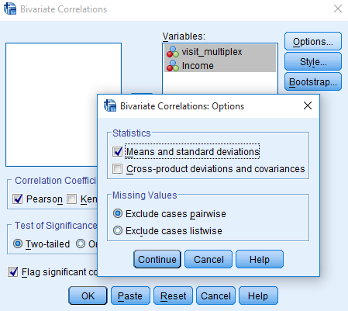
SPSS Path for Descriptive Statistics and Correlation Coefficient
Exhibit 12.3. Use multiplex.sav » Menu bar » analyse » Correlate » Bivariate » Select and transfer visit and Income to Variables box » Click Options and select Mean and standard deviation (optional if interested) under Statistics » Click OK

Slide 17
Interpreting Outputs of Pearson’s Product-Moment Correlation
Pearson Moment Correlation Coefficient­
Table 12.3. Pearson Moment Correlation Coefficient
The visit to a multiplex is strong and positively associated (r = 0.638) with monthly household income. The lower value (p < 0.01, p = 0.000) of Sig. (2-tailed) also indicates that the association is found significant at 1 per cent alpha.
 |  | Visit Multiplex | Income
Visit multiplex | Pearson Correlation (r) | 1 | 0.638*
 | Sig. (2-tailed) |  | 0.000
*Correlation is significant at the 0.01 level (2-tailed).
Lokesh Jasrai (2020), SAGE TEXTS

Slide 18
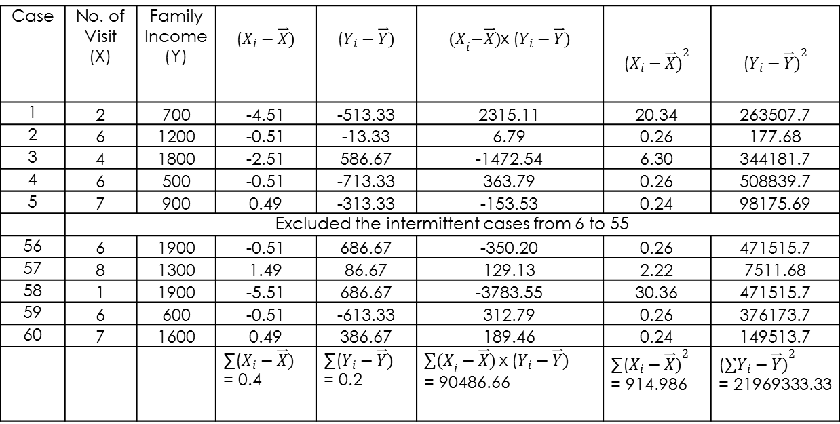
Sample Data and Formulae for Pearson Correlation Coefficient
Table 12.4. Sample Data: Pearson Correlation Coefficient
Case | No. of Visit (X) | Family Income (Y)
1 | 2 | 700 | −4.51 | −513.33 | 2315.11 | 20.34 | 263507.7
2 | 6 | 1200 | −0.51 | −13.33 | 6.79 | 0.26 | 177.68
3 | 4 | 1800 | −2.51 | 586.67 | −1472.54 | 6.30 | 344181.7
4 | 6 | 500 | −0.51 | −713.33 | 363.79 | 0.26 | 508839.7
5 | 7 | 900 | 0.49 | −313.33 | −153.53 | 0.24 | 98175.69
 | Excluded the intermittent cases from 6 to 55
56 | 6 | 1900 | −0.51 | 686.67 | −350.20 | 0.26 | 471515.7
57 | 8 | 1300 | 1.49 | 86.67 | 129.13 | 2.22 | 7511.68
58 | 1 | 1900 | −5.51 | 686.67 | −3783.55 | 30.36 | 471515.7
59 | 6 | 600 | −0.51 | −613.33 | 312.79 | 0.26 | 376173.7
60 | 7 | 1600 | 0.49 | 386.67 | 189.46 | 0.24 | 149513.7

Slide 19
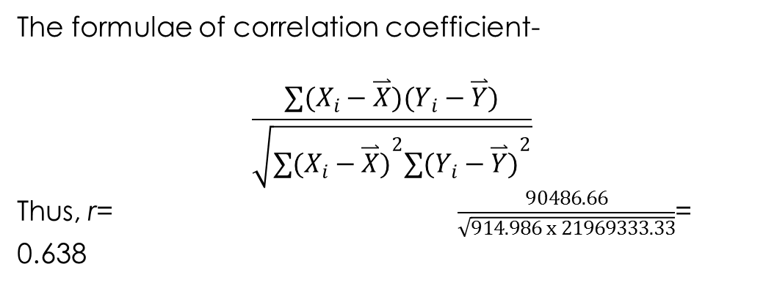

Slide 20
Partial Correlation
The partial correlation measures the strength and direction of a linear association between two variables after controlling the effects of one or more other independent variables in the study (Brown and Hendrix 2014).
Simplest partial correlation includes three variables, one dependent and independent variable and one control variable. The result of partial correlation is also presented as correlation coefficient (r_{partial}).
The value of r_{partial} ranges from −1.0 to +1.0 (Salkind, 2010). The subscript indicates correlated variables along with the controlling variable.

Slide 21
Research Problem and Test Technique
In the partial correlation, investigating the relationship between frequencies of visits and monthly income, we also want to ascertain the effect of family size as covariate in the initially correlated variables.
In view of this, we use all three variables in the data set multiplex.sav to examine the relationship between visits and monthly income after controlling the family size.

Slide 22
Framing Hypothesis
Null hypothesis H₀: ρ = 0
(When removing the effect of control variable, the population correlation coefficients (ρ) is equal to zero.)
We can also express the null hypothesis, indicating no relationship between the variables.
H₀: (When removing the effect of control variable, no significant correlation exists between the two variables.)
Alternative hypothesis H_{a}: ρ ≠ 0
(When removing the effect of control variable, population correlation coefficients (ρ) is not equal to zero.)

Slide 23
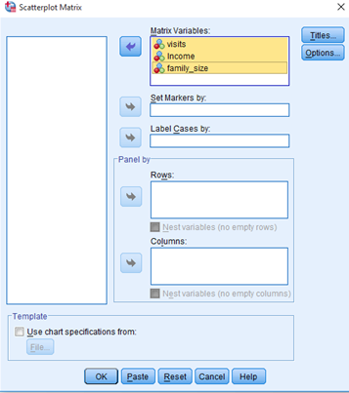
Executing Partial Correlation with SPSS Procedure
Assessing Linear Relationship
Exhibit 12.4. Use multiplex.sav » Graphs » Legacy Dialog » Scatter plot » Matrix scatter » Select visits, Income and family size (pressing shift) transfer in Matrix Variables box » Click OK

Slide 24
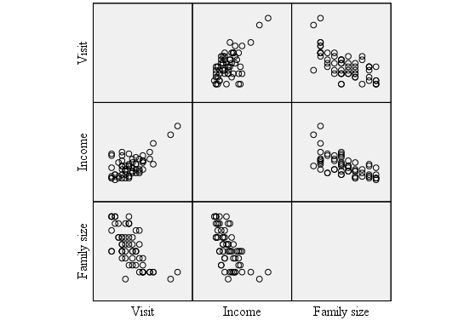
Result: Matrix Scatter Plots
A linear positive association can be seen between visit-income, whereas negative associations appear for the pairs visit-family size and income-family size.

Slide 25
Assessing Normality
Table 12.5. Normality with One-Sample KS: Partial Correlation
 | N | Normal Parameters |  | K–S Z | Sig. (2-tailed)
 |  | Mean | Std. Deviation
Family size | 60 | 5.5 | 2.7 | 0.111 | 0.062
Table 12.5 presents a mean (5.5) score and standard deviation (2.7) of family size. The p-value (Sig. (2-tailed)) for family size as shown in last column (p > 0.05, 0.062) is more than 0.05. Hence, we fail to reject null hypothesis of normality.

Slide 26
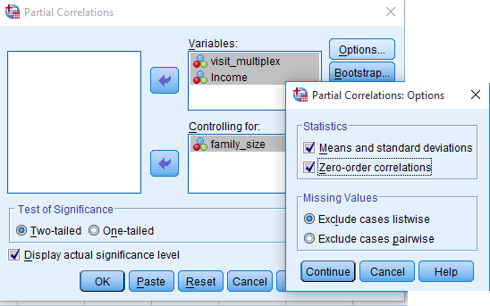
SPSS Path for Descriptive Statistics and Partial Correlation Coefficient
Exhibit 12.5. Use multiplex.sav » Menu bar » analyse » Correlate » Partial » Select and transfer visit and Income to Variables box » Select family size and transfer to Controlling box » Click Options and select Means and standard deviations (optional to select) and Zero-order correlations under Statistics » Click OK

Slide 27
Interpreting Outputs of Partial Correlation
Partial Correlation Table
Table 12.6. Correlation Table: Partial Correlation
Part A
Control Variables |  |  | Visit (X) | Income (Y) | Family (Z)
None | Visit (X) | Correlation | 1.000
 |  | Sig. (2-tailed) | ---
 | Income (Y) | Correlation | 0.638 | 1.000
 |  | Sig. (2-tailed) | 0.000 | ---
 | Family Size (Z) | Correlation | −0.675 | −0.647 | 1.000
 |  | Sig. (2-tailed) | 0.000 | 0.000 | ---
Part-b
Family size (Z) | Visit (X) | Correlation | 1.000
 |  | Sig. (2-tailed) | ---
 | Income (Y) | Correlation | 0.358 | 1.000
 |  | Sig. (2-tailed) | 0.005 | --- | ----
Part a: Cells contain zero-order (Pearson) correlations.

Slide 28
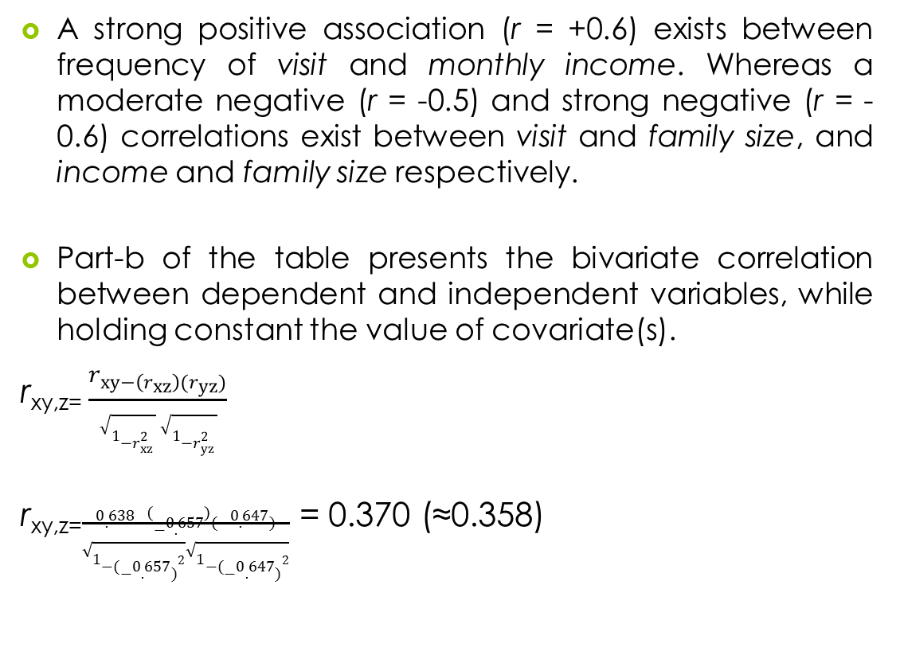

Slide 29
Reporting the Results of Pearson’s Product-Moment and Partial Correlation
A strong positive Pearson’s product-moment correlation exists (r = 0.638; p < 0.05, 0.000) between visit (X) to multiplex and family household income (Y).
A strong negative correlation (r = −0.675; p < 0.05, 0.000) exists between visit (X) to multiplex and family size (Z) and between household income (Y) and family size (Z).
Finally, the partial correlation between visit (X) to multiplex and family household income (Y) is significant but week positive (r = 0.358; p < 0.05, 0.000) in nature.

Slide 30
Key Terms
Bivariate correlation Causal relationship Correlation coefficient Covariates Partial correlation | Pearson’s Product-moment correlation Population correlation coefficients Relational hypothesis Zero-order correlation

